Slide 1
GelMA
Sara Javadi
Ph.D. Candidate at
Department of Pharmaceutical Biomaterials and Medical Biomaterials Research Center, Faculty of Pharmacy, Tehran University of Medical Sciences, Tehran, Iran

Slide 2
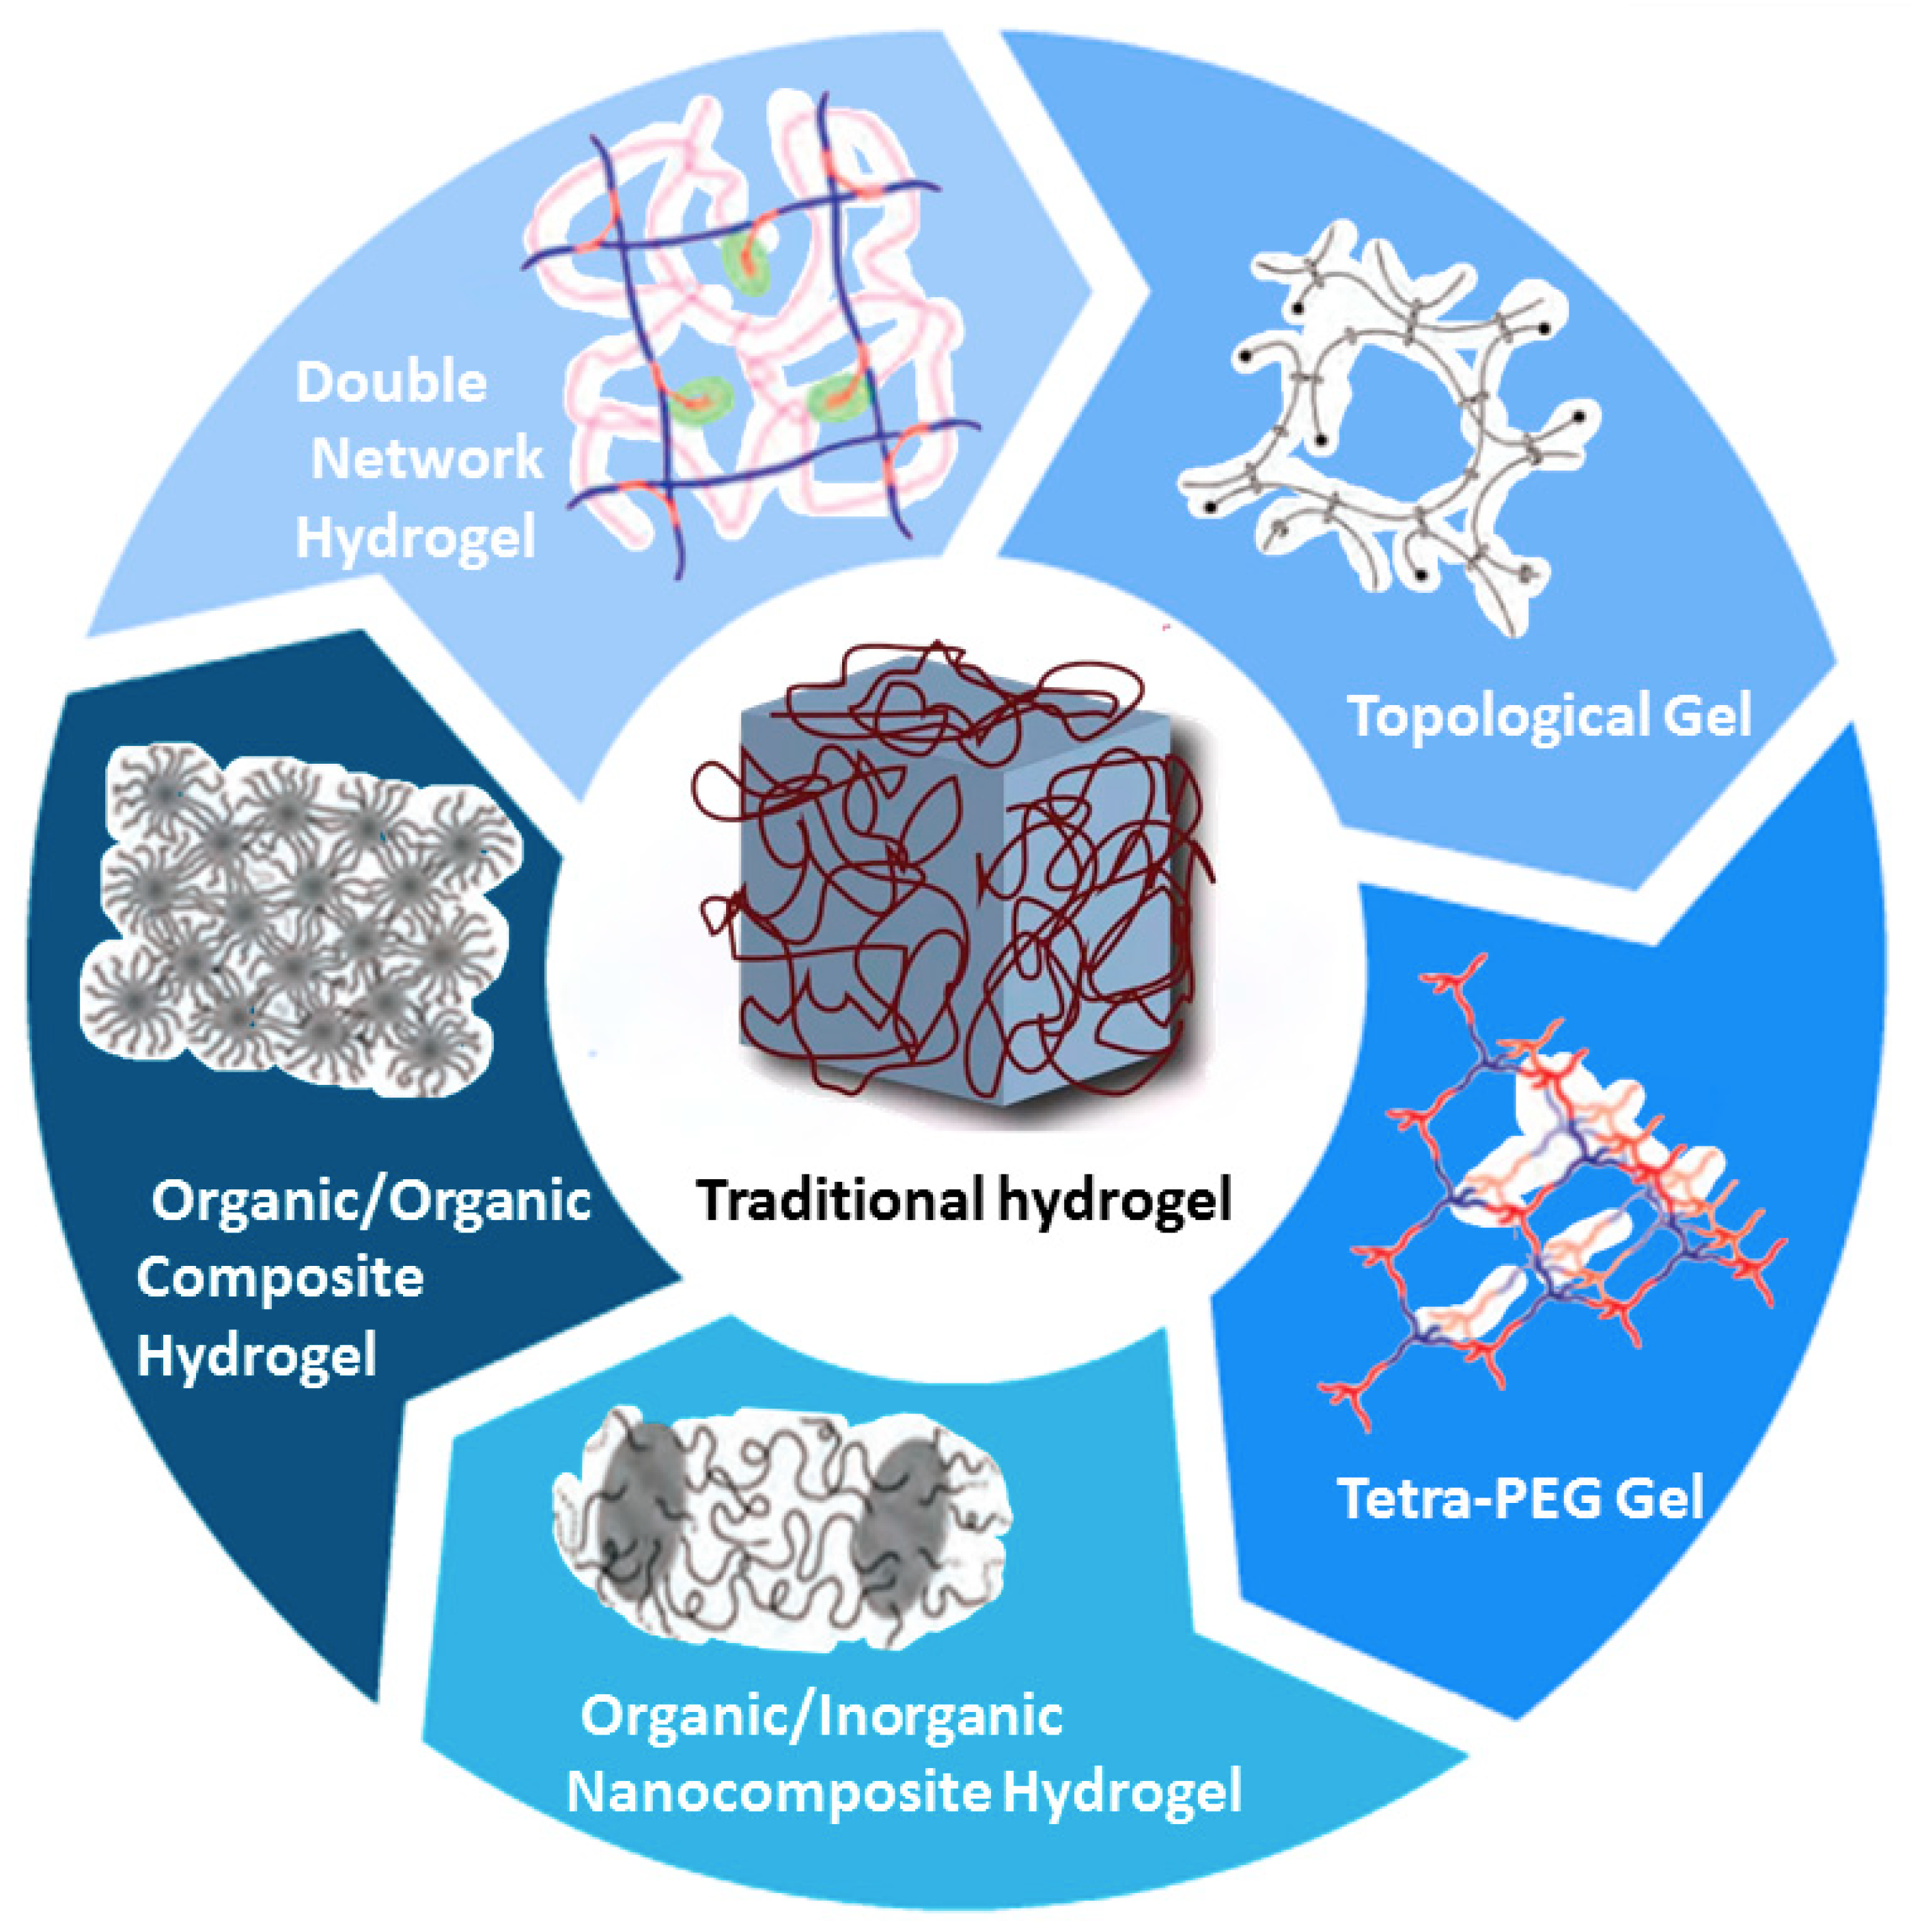
Hydrogel

Slide 3
Gelma
Developed in 2000
By Van den Bulcke et al
limitations of gelatin hydrogels:
Basic gelatin is soluble at body temperature
The solidification of gelatin could be achieved by glutaraldehyde, it is cytotoxic, time consuming, and highly uncontrollable

Slide 4
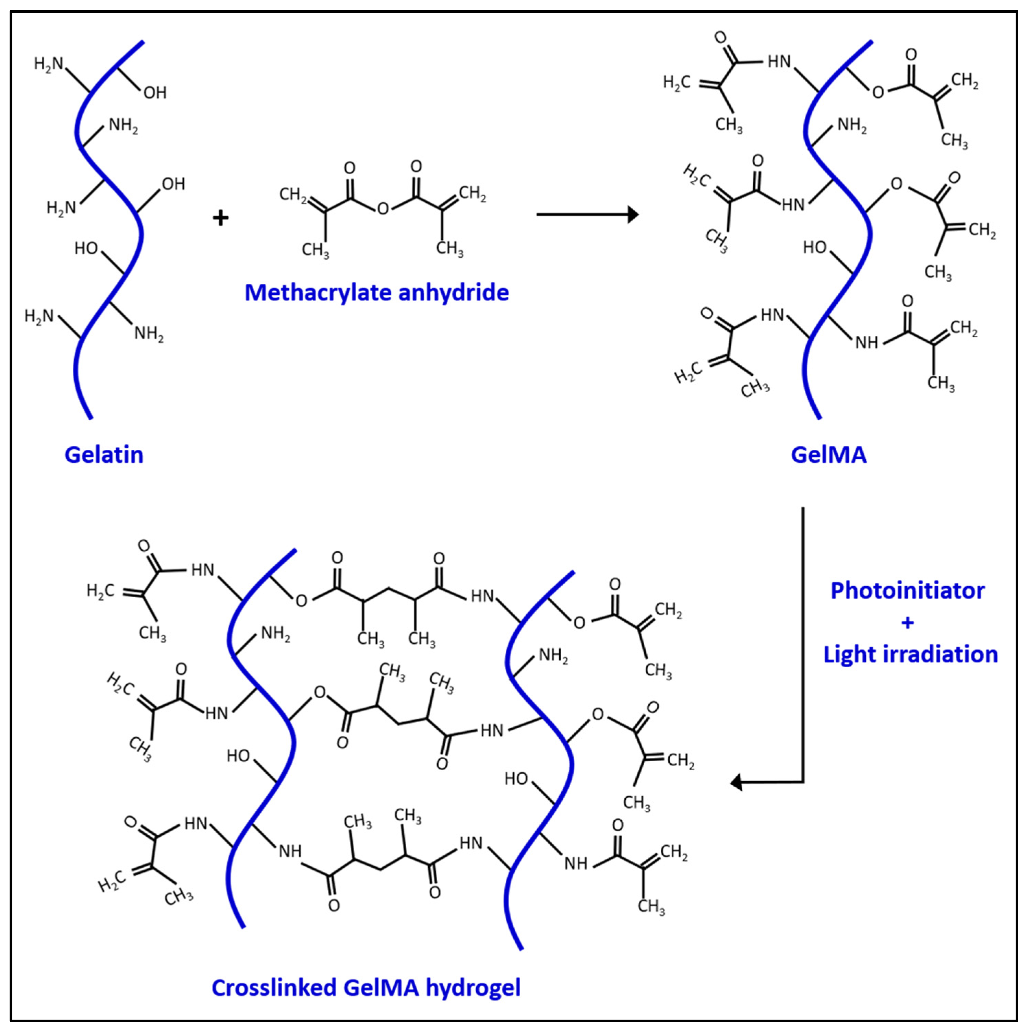

Slide 5
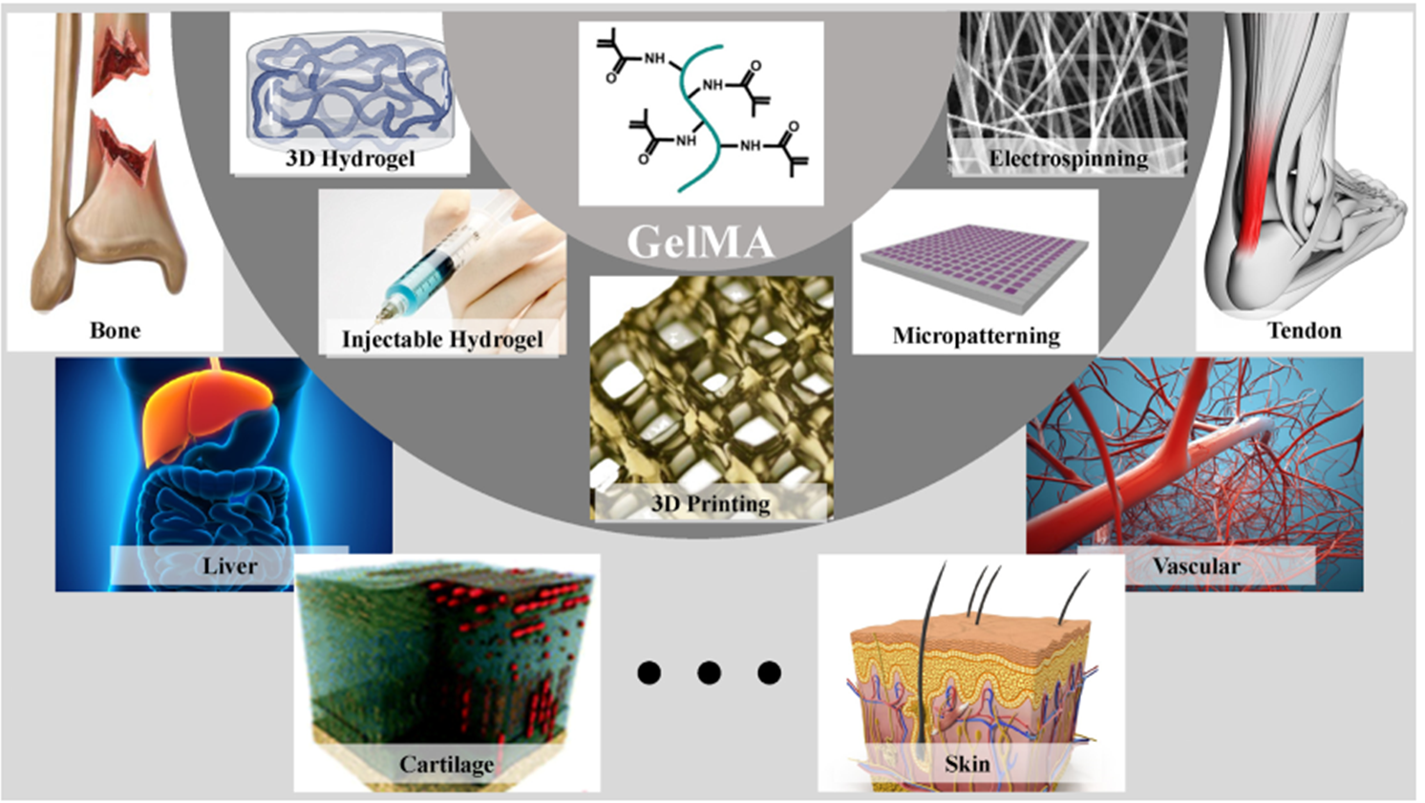

Slide 6
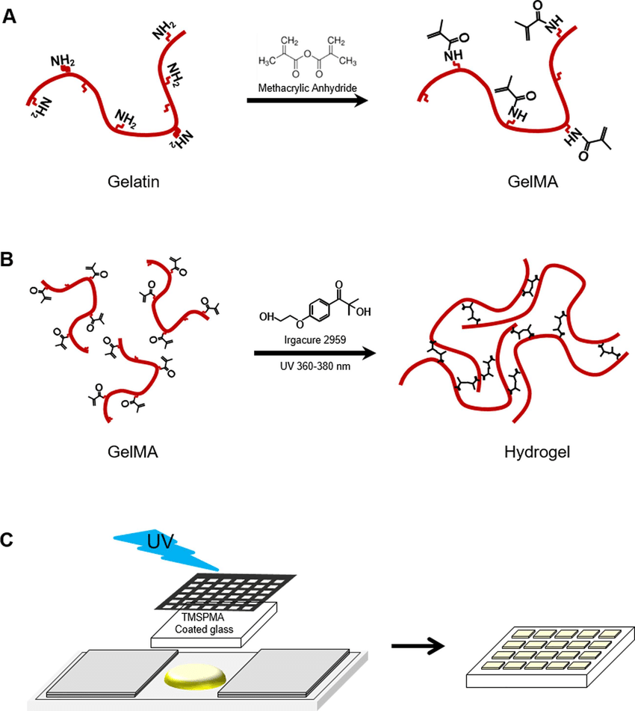
Synthesis of GelMA hydrogels

Slide 7
crucial parameter for controlling mechanical property, water retention, and degradability of GelMA:
Amount of carbon double bonds substituted with MA in a single GelMA molecule
degree of substitution (DS)
In PBS solution (7 < pH < 8), the DS range from 5.7% to 76.0% with increasing amounts of MA up to 1.0 mL/g (MA/GelMA)
The use of carbonate-bicarbonate buffer at higher pH (8 < pH < 11) raises the DS to over 95% despite using only onetenth of the amount of MA in PBS

Slide 8
GelMA hydrogel is featured with robustly adjustable physical properties:
mechanical, degradation, and swelling properties
Advanced fabrication technologies: bioprinting, microfluidics, electrospinning, and micromolding
Different formats: including micro/nanopatterns, micro/nanospheres, micro/nanofibers, and 3D tissue scaffolds or models for drug screening and disease modeling

Slide 9
Problem and Solution
Problem | Possible Solution
Too low viscosity to achieve high-resolution 3D printing or even has no printability at low concentration. | 1. Add a viscosity-enhancing modifier, such as alginate, to improve the printability without changing the GelMA hydrogel’s concentration. 2. Improvement of 3D printers in the future: A nozzle that can cool the GelMA bioink during extrusion.
Too soft to provide enough mechanical strength in some applications, such as bone regeneration grafts. | Build a frame with a stronger material, for instance, polylactic acid (PLA)
The fast degradation rate limits its application in long-term drug delivery systems and increases the potential cytotoxicity due to the rapid elevation of exogenous drug levels in vivo . | GelMA hydrogel could be synthesized into nanoparticles and incorporated into less degradable materials such as synthetic polymer nanofibers.

Slide 10
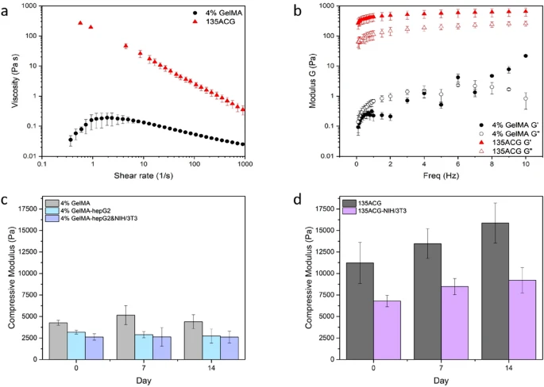
Rheological Characterization

Slide 11
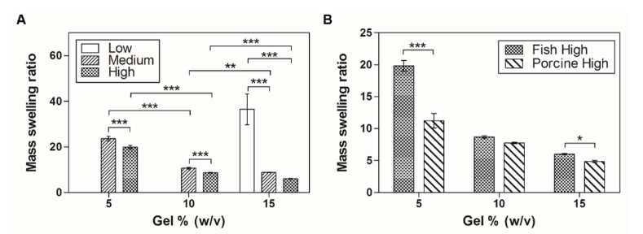
Swelling Properties of GelMA

Slide 12


